Slide 1
Probability
Data generation

Slide 2
Urns

Slide 3
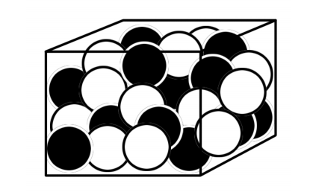
Urns
Imagine an urn with 10 balls: 5 white and 5 black
We will use this urn to generate colors at random:
Draw a ball
Record the color
Put it back and shuffle

Slide 4
What type of data is it?
Example: White, White, Black, White, Black, …
Which distribution?
With what parameter?

Slide 5
What if we put in 10 white balls?
What changed?
What is it now?

Slide 6
What if we put in 10 white balls?
What changed?
What is it now?
If we know exactly what it is, we can simulate from it
[Notebook]

Slide 7
We can express it graphically
p
Data

Slide 8
We can express it graphically
f
p
Data

Slide 9
Example?
Suggest a measurement
Typically:
What does it look like?
What is the support?
What is the mean?
What is the variance?
Volunteer

Slide 10
Generative model

Slide 11
If we know the parameters...
f(x|params)
Parameters
x₁,x₂,x₃,...

Slide 12
Bayesian Interpretation of Probability
Uncertainty

Slide 13
On average...?
Most of the time, what we know are expected ranges.
When talking about a measurement, averages are not enough.
f(x|params)
Parameters?

Slide 14
Prior distribution
Helps us express uncertainty about the parameters
f(x|params)
Parameters?

Slide 15
Back to the urn
What if I'm only told there is 1 ball?
You have to guess the color

Slide 16
Back to the urn
What if I'm only told there is 1 ball?
You have to guess how many white there will be in 10 trials
I could express my uncertainty using a distribution: equivalent to flipping a coin

Slide 17
Back to the urn
What if I'm only told there are 9 balls?
You have to guess how many white there will be in 10 trials
I could express my uncertainty using a distribution: rolling a 10-sided die

Slide 18
None of this is statistics!
f(x|params)
Parameters
x₁,x₂,x₃,...

Slide 19
This would be statistics
f(x|params)
Parameters
x₁,x₂,x₃,...

